Slide 1

Final Presentation
Classification and Prediction
Luke Stucky

Slide 2
Classification
Business Problem
A high-end financial institution is working on reducing credit default rates while identifying high-risk customers. This will allow the institution to improve profitability and minimize financial losses. As the head data analyst, I am working on developing a reliable classification system that can predict whether a customer will default on their credit obligations. Doing this will allow the institution to be more effective in their selection of customers and increase their reputation as a high-end financial institution.

Slide 3
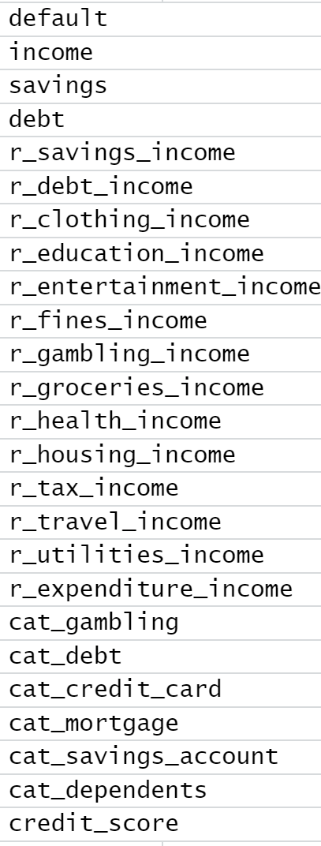
Classification
Data
Data was used for both classification and prediction.
Credit score data that was randomly generated.
Started with 87 variables and cut it down to 25.
Kept ratio variables, categorical variables, and the integer variables.
Turned default into factor to be the dependent variable in classification.
No missing values were in the data.
https://www.kaggle.com/datasets/conorsully1/credit-score

Slide 4
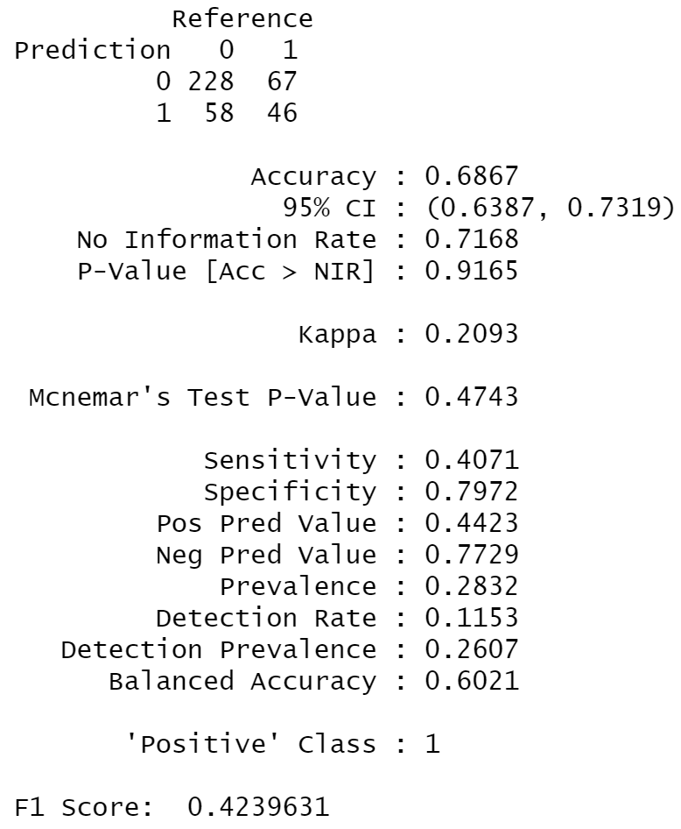
Classification
KNN Model
We have 10 nearest neighbors.
Our model had an accuracy of around 72% before threshold tuning.
Threshold tuning balanced sensitivity and specificity and increased the F1 score by .19 but reduced the accuracy by about 4%.
The positive predictive value shows we get 44% of default predictions right.

Slide 5
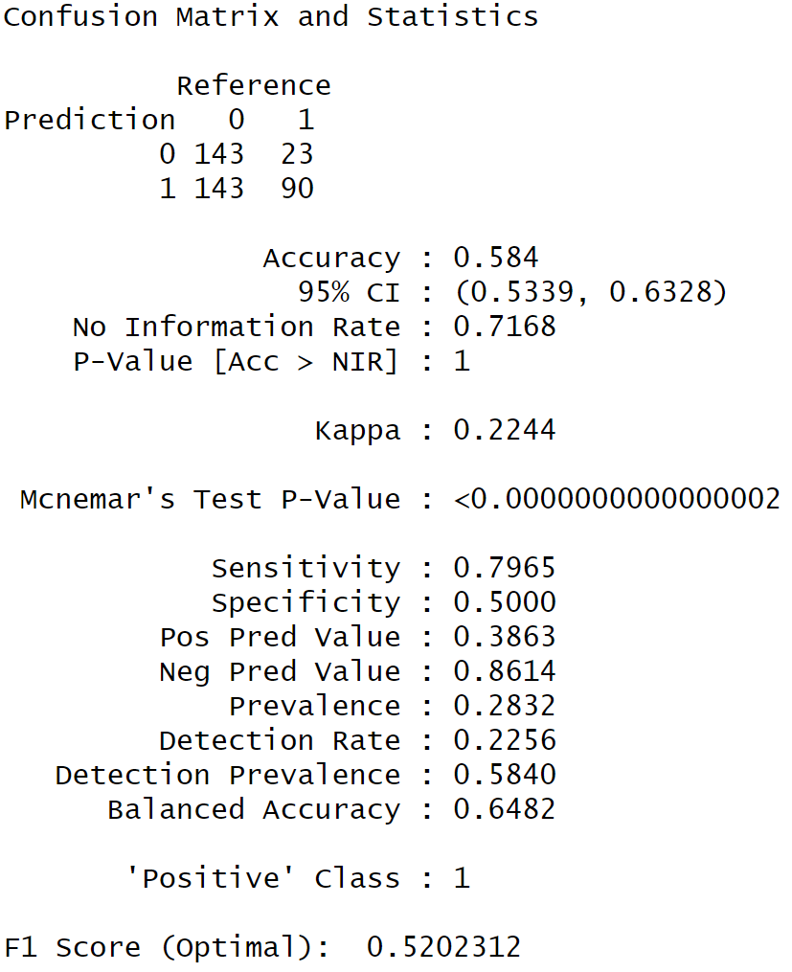
Classification
Logistic Regression Model
Running a regression the first time showed us that credit score is highly significant.
The most significant predictor is credit_score even after removing variables with high VIFs.
Our accuracy decreased from 75% to 58% after default cutoff.
The positive predictive value means that 38.63% of the predicted defaults are correct.

Slide 6
Classification
Evaluation
Model decision comes down to minimizing false negatives or false positives.
False negatives are more important as we need to prevent defaulting.
McFadden 0.1285 and Nagelkerke of 0.2042.

Slide 7
Classification
Deployment
Our model shows some predictive power but needs improvement.
Credit score is crucial for predicting defaults.
Recommendations:
Enhance credit scoring models.
Thoroughly score applicants with lower credit scores.
Do a deep dive to uncover additional predictors of defaulting.

Slide 8
Prediction
Business Problem
Following the classification model aimed at reducing credit defaults, the financial institution is now focused on predicting credit scores more accurately to enhance their decision-making process. The classification model helped the institution identify high-risk customers, but predicting credit scores will allow the institution to fine-tune its offerings based on a customer’s exact creditworthiness. Accurate credit score predictions can allow the institution to offer personalized financial products, better interest rates, and improve overall customer satisfaction.
As the head data analyst, I am now seeking to improve the institution's ability to predict customers' credit scores based on their financial behaviors. This predictive model will provide an understanding of the financial health of applicants, allowing for more informed lending decisions and more targeted risk management strategies.

Slide 9
Prediction
Regression With and Without Interaction
Without Interaction
Debt to income variable
Significant negative impact
Adjusted R-squared
0.7844
Overall Model Significance
F-statistic of 46.24 and p-value < .05
MAPE of 3.99% and RMSE of 29.3
With Interaction
Debt to income variable still most impactful
Adjusted R-squared
0.8521
Overall Model Significance
F-statistic of 102.7 and p-value < .05
MAPE of 4.2% and RMSE of 31.94

Slide 10
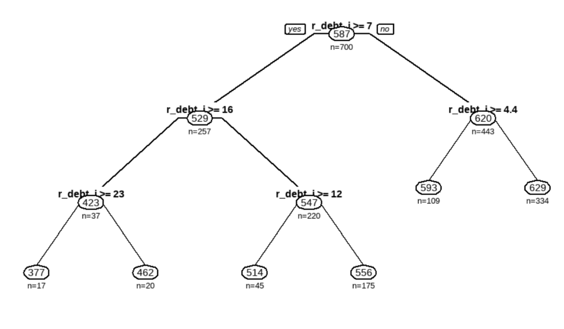
Prediction
Regression Tree
Optimal Tree
Default tree split 6 times. Five of those splits were by r_debt_income.
Used minimum error cp (0.013001) to generate optimal tree.
Optimal tree splits five times and all on r_debt_income.
MAPE of 4.58% and RMSE of 33.6

Slide 11
Prediction
Evaluation
Model 1: Regression without Interaction:
Provides a decent RMSE and an excellent MAPE, indicating strong overall performance.
Model 2: Regression with Interaction:
Improved adjusted R² significantly but had inferior RMSE and MAPE compared to the simple regression model.
Model 3: Regression Tree:
Produced RMSE and MAPE values close to the other two models but still performed worse.
Deployment Readiness:
The simple regression model, with its smallest RMSE and MAPE, is the most promising for deployment.

Slide 12
Prediction
Deployment
Predictive Performance:
Current model is performing well with a decent RMSE and an excellent MAPE.
We are on the right track for predicting credit scores accurately, but there is still room for improvement.
Translating Insights to Classification:
Insights gained from predicting credit scores can be translated back to the classification problem.
This will allow us to better identify customers at higher risk of defaulting.

Slide 13
Faith Integration | Ethical Consideration
Working with credit score data presents ethical challenges that can’t go unnoticed.
Credit scoring models can target certain people, and they contain personal information.
It is vital to gain proper consent and clearly communicate data practices.
As a Christian data analyst, I must practice justice and accountability in my practice.

Slide 14
Questions?

